Slide 1
Graduate Statistics PSYC 640
Fall 2023

Slide 2



Installing r & R-studio
LINK TO INSTALL GUIDE
Notes:
https://rstudio-education.github.io/hopr/starting.html

Slide 3
Rstudio cloud (posit cloud)
https://posit.cloud/plans/free
Cloud version of RStudio
Signup for the free version

Slide 4
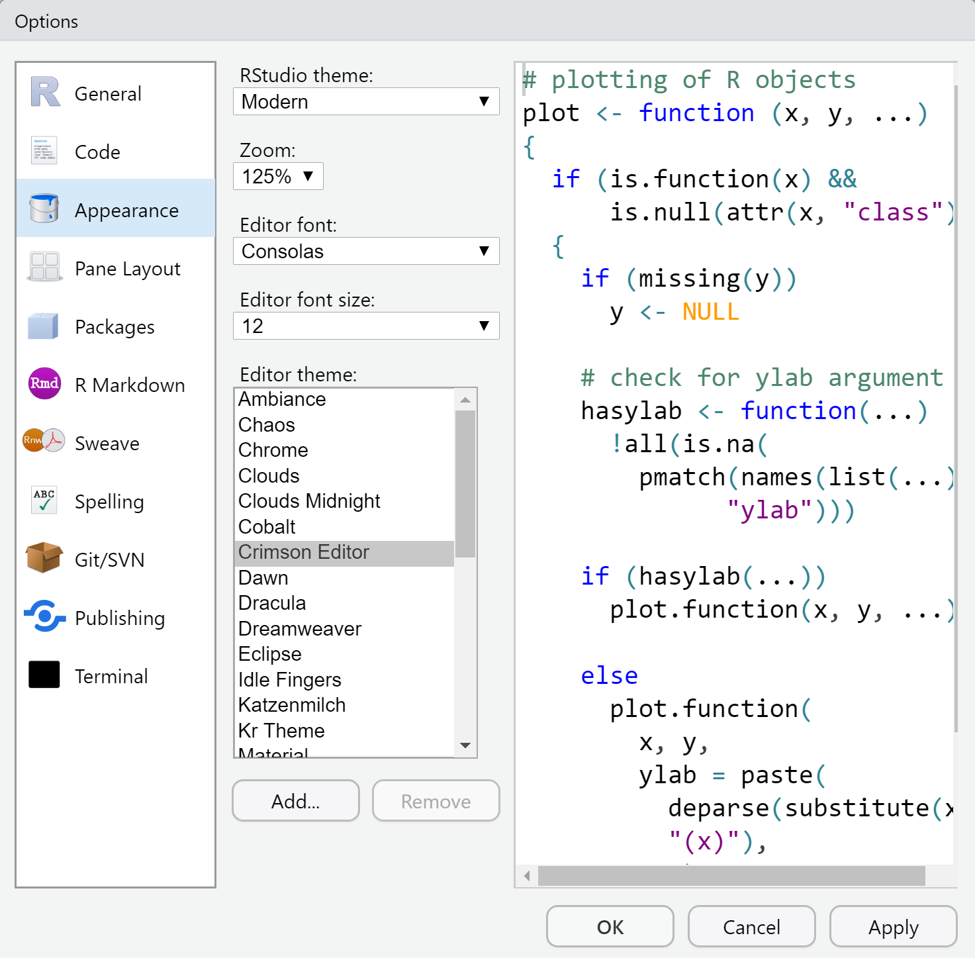
Customization
Tools > Global Options > Appearance
Organize the Pane Layout however you would like
Update the appearance! This is your program and it should look how you want it to

Slide 5
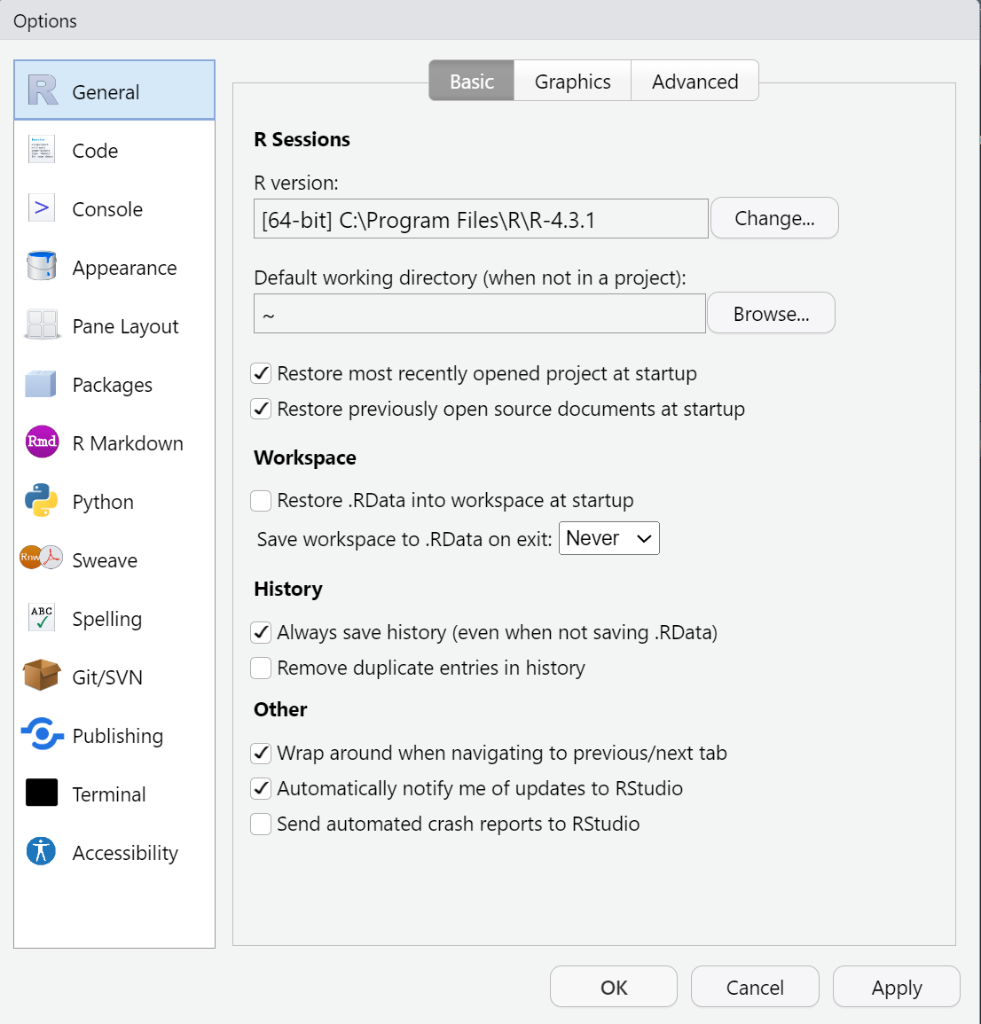
Start with a blank slate
By default, R Studio saves all of the objects in your environment. In general, this is not ideal, because it means that you may have taken steps interactively that are not documented in your code.
Navigate to Tools > Global Options

Slide 6
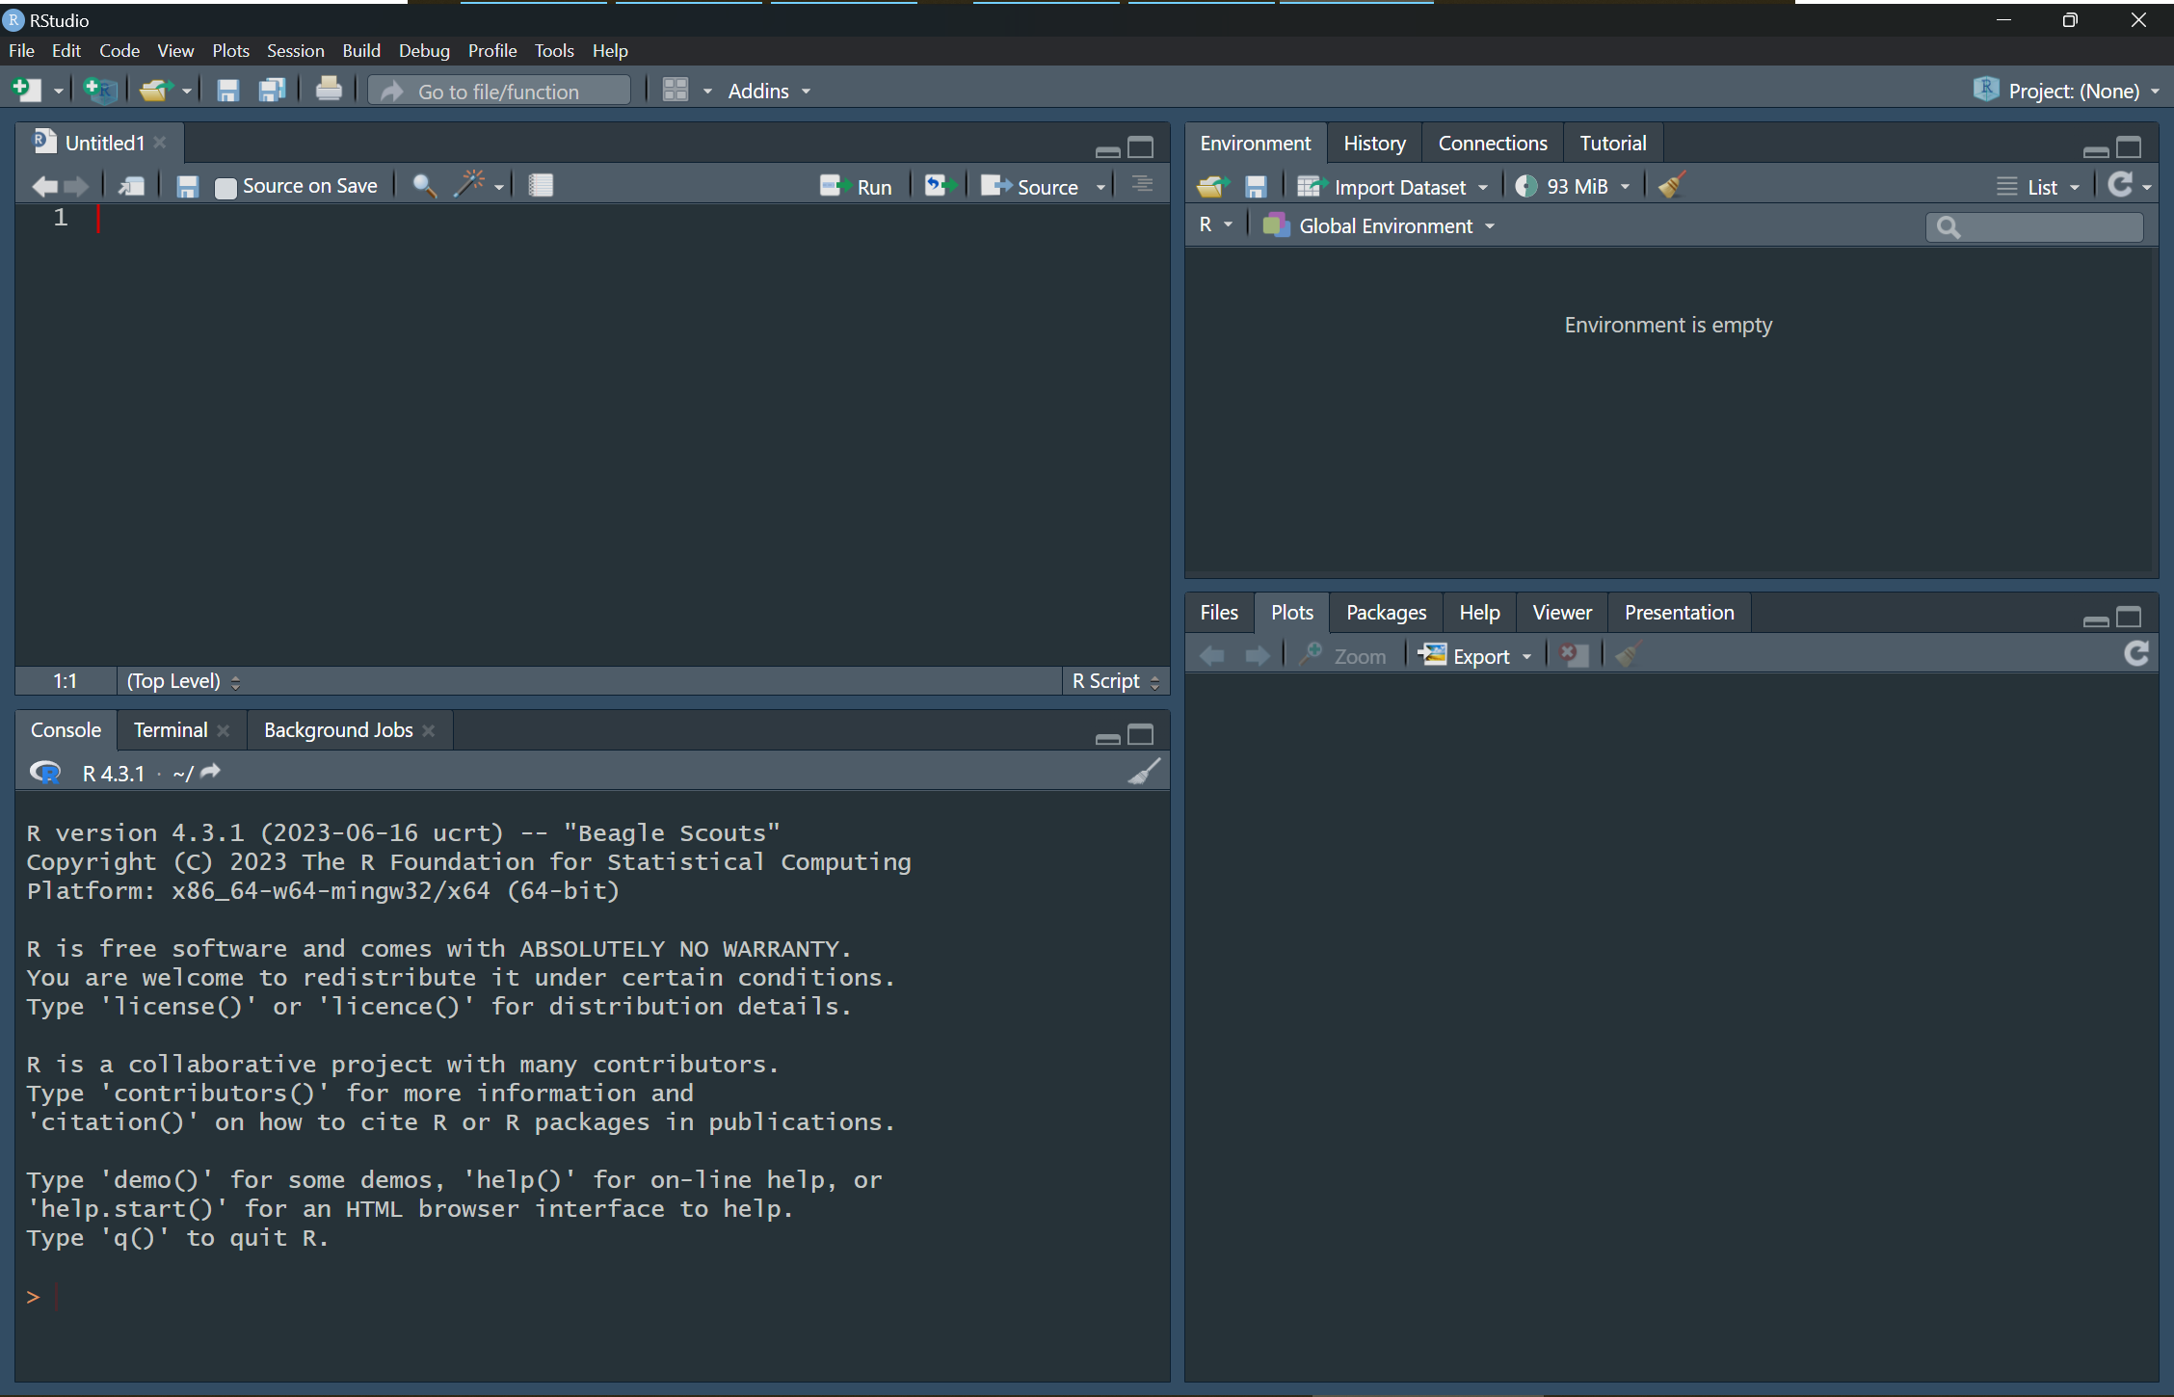
Script Editor – Where you write your script. You can save it and keep your “recipe”
Environment – Where your data and the objects you create will be stored
Viewer Pane – This is where plots an tables will appear
Console – Here you will see the code you have run as well as output/results from the tests

Slide 7
Rstudio - Console
You can type directly into this
It will not be saved
Simplest thing is to use it as a calculator! Go ahead and try it out
Type 42 + 13 and hit ENTER ← This is a command
You are commanding the computer to perform the task that you want
Note: Take a look at 3.2 in Learning Statistics with R
Another resource is R for Data Science Chapter 3

Slide 8
RSTUDIO – Console & Environment
Creating Objects
“Objects” are containers for information
They are created by using the assignment operator <-
Shortcut for inserting the operator: Alt + - (minus sign)
Try it out! Create an object named “class” and assign it the number of students (16)
Once it is run, you will not see it in the console, but it will appear in the Environment
Manipulating Objects
You can use object names in calculations
What happens if 4 students leave the class, how many are left?
Call the object again…did it change?
Updating objects

Slide 9
RSTUDIO – Console & Environment
Using Functions
Create object class_grade and assign it a list of numbers (separated by commas) using the combine function c()
Use a function to find the average of the grades using a function (Use Google)
Calculate the average manually (with R) to see if they match!
Create an object class_average that has the class average that you calculated
Maybe you don’t want that many decimal places…

Slide 10
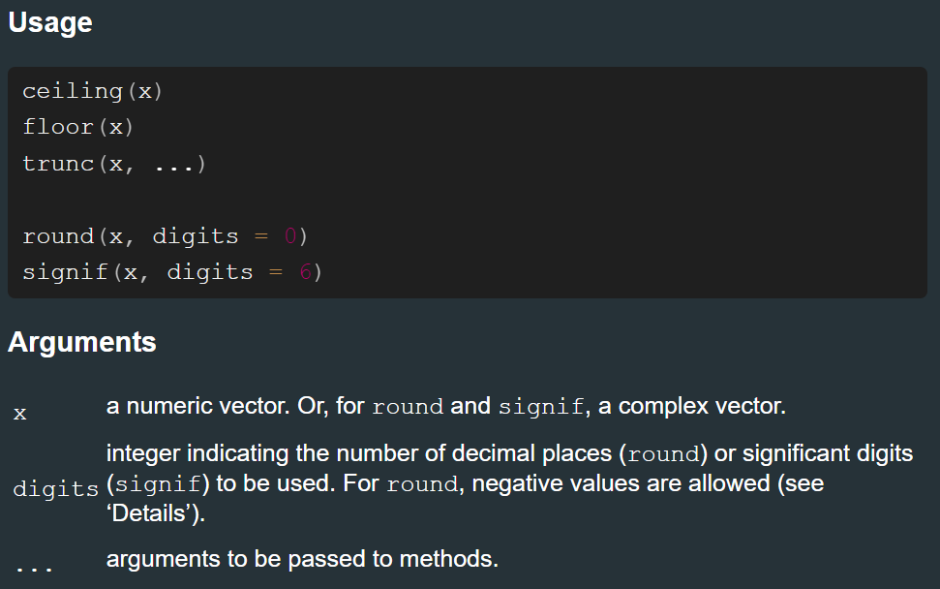
RSTUDIO – Console & Environment
Using Functions
The round() function (?round)
Function name & corresponding arguments

Slide 11
Closing rstudio
What will happen with the objects we created once we close and re-open Rstudio?
What about all the other work that you did?

Slide 12

Closing rstudio
What will happen with the objects we created once we close and re-open Rstudio?
What about all the other work that you did?
It looks like you are trying to use Rstudio but all of your information was deleted. Maybe you shouldn’t just use the console. Would you like some help?
Yes No

Slide 13
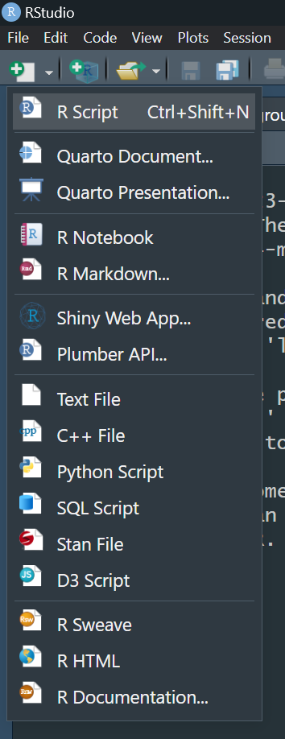
Rstudio – Scripts & markdown / notebook
Scripts & Markdown/Notebooks are like the recipes
These are the documents that you will be saving in order to continue your projects
Create one script and one notebook
When creating a notebook, you may be prompted to update “a version of the markdown package” – Select Yes
What are some differences that you notice between the two?

Slide 14
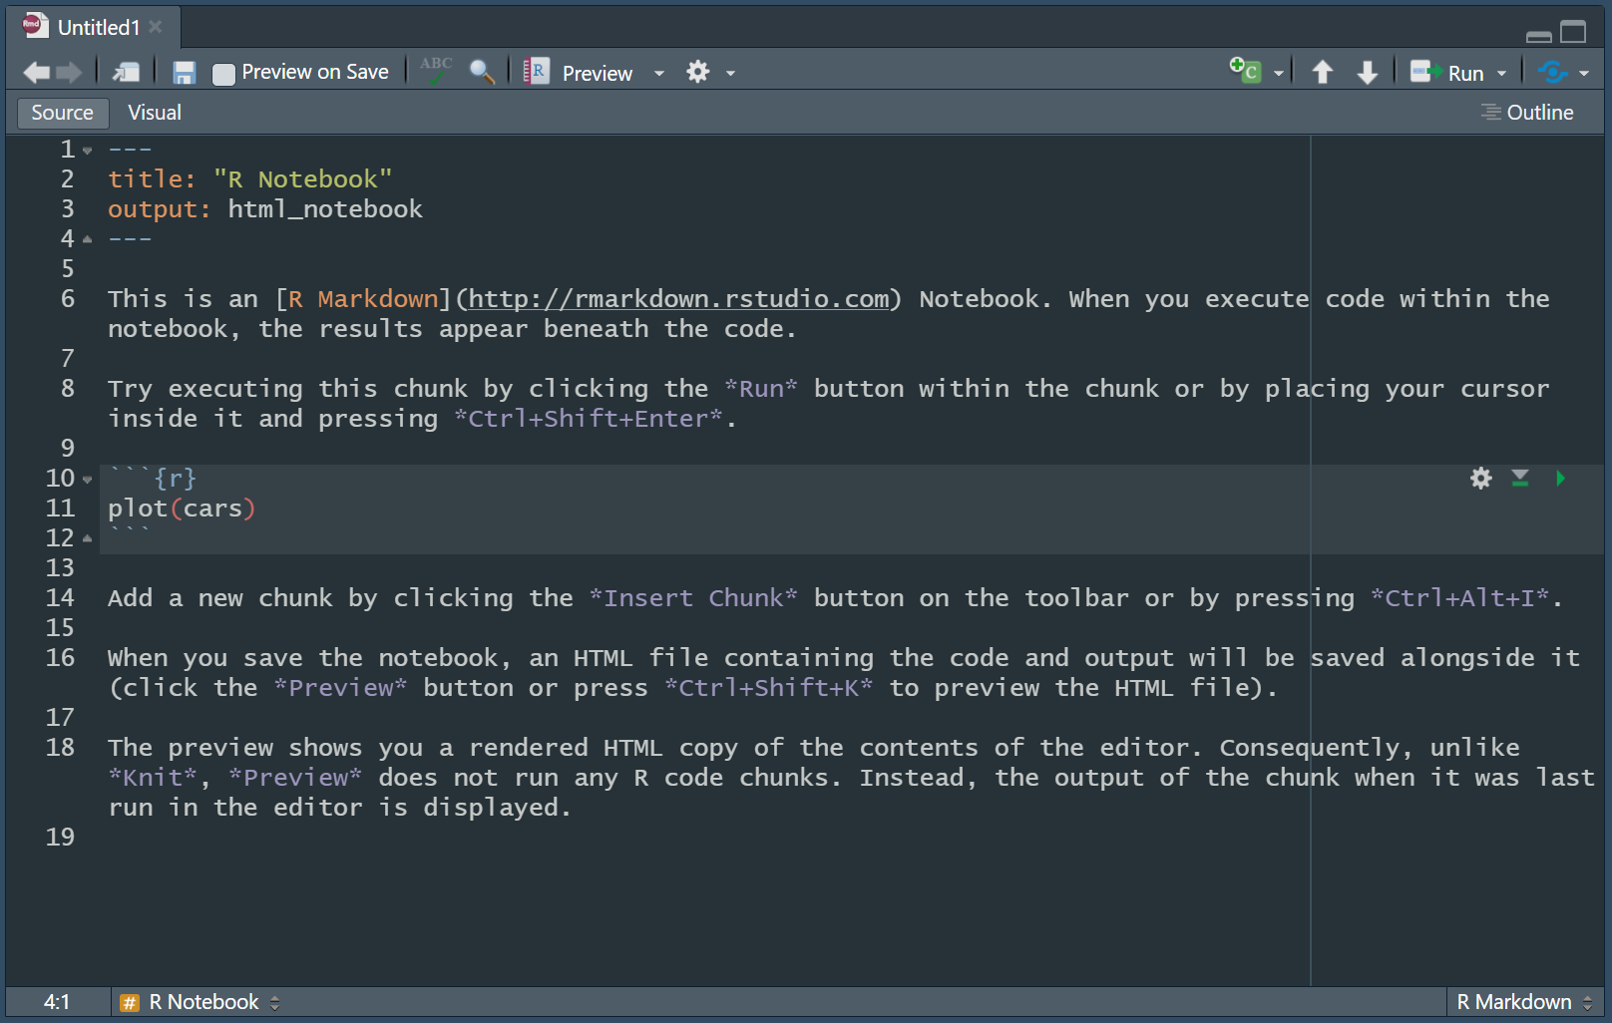
Rstudio - notebook
Normal Text
Code chunk

Slide 15



The Library of R
“A package is a like a book, a library is like a library; you use library() to check a package out of the library”
Hadley Wickham, Chief Scientist, R Studio

Slide 16
The Library of R - install.packages()
"Packages" are shareable collections of R code that provide functions (i.e., a command to perform a specific task), data, and documentation. Packages increase the functionality of R by improving and expanding on base R (basic R functions).
Installing and Loading Packages
To download a package, you must call install.packages():
install.packages("tidyverse")
You can also navigate to the Packages pane, and then click "Install", which will work the same as the line of code above. This is a way to install a package using code or part of the R Studio interface.
Usually, writing code is a bit quicker, but using the interface can be very useful and complementary to use of code.
Put this in the console
Notes:
https://jrosen48.github.io/MSU-workshop-2019/#10

Slide 17
The Library of R - library()
After the package is installed, it must be loaded into your R Studio session using library():
library(tidyverse)
We only have to install a package once, but to use it, we have to load it each time we start a new R session.
Notes:
https://jrosen48.github.io/MSU-workshop-2019/#11

Slide 18

install.packages(“here”)
library(here)
CRAN

Slide 19

Putting it all together

Slide 20
Putting it together - overview
Step 1: Create File Structure
One folder for the current project
Download the data to put in there
Step 2: Create Notebook (helpful resource for further reading)
Install packages – here()
Put libraries in the code chunk
Step 3: Load in Data
Using haven package (https://haven.tidyverse.org/)

Slide 21
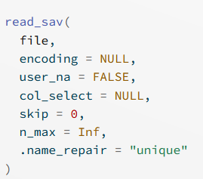
RSTUDIO – Importing/Reading data
file – refers to where on your computer this file lives. How can you give directions to get to this specific data file?

Slide 22

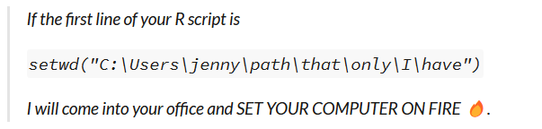
RSTUDIO – Importing/Reading data

Slide 23
Wrapping up
No class on Monday (9/4) – Labor Day
No office hours Thursday (8/31)
Read the “Open Science Collaboration 2015” that is on MyCourses to prepare for next week

